Slide 1
7.3 Knock-out Barrier Option
指導教授：戴天時
學 生：王薇婷

Slide 2
There are several types of barrier options.
Some “Knock out” when the underlying asset price crosses a barrier (Up-and-out, Down-and-out). Other options “Knock in” at a barrier (Up-and-in, Down-and-in).
The payoff at expiration for barrier options is typically either that of a put or a call. More complex barrier options require the asset price to not only cross a barrier but spend a certain amount of time across the barrier in order to knock in or knock out.
7.3.1 Up-and-Out Call
7.3.2 Black-Scholes-Merton Equation
7.3.3 Computation of the price of the Up-and-Out Call

Slide 3
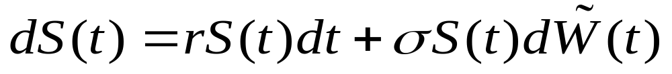

7.3.1 Up-and-Out Call
Our underlying risky asset is geometric Brownian motion
Where is a Brownian motion under the risk-neutral measure .
Consider a European call, expiring at time T, with strike price K and up-and-out barrier B. We assume K<B; otherwise, the option must knock out in order to be in the money and hence could only pay off zero.

Slide 4
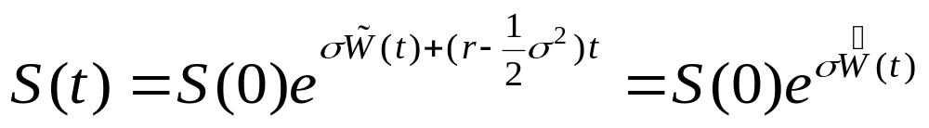
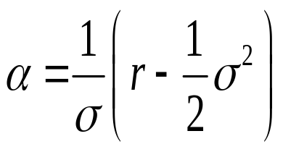
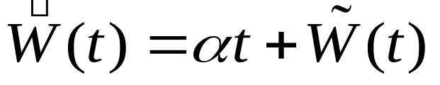
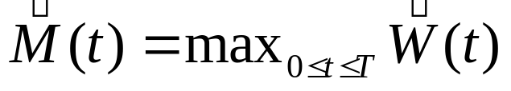
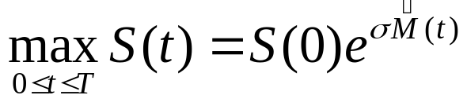
The solution to the stochastic differential equation for the asset price is
Where , and
We define ,
so

Slide 5
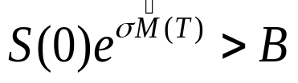

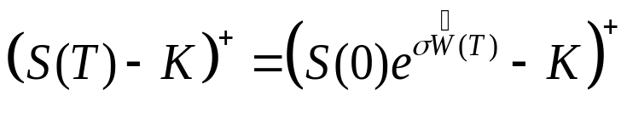
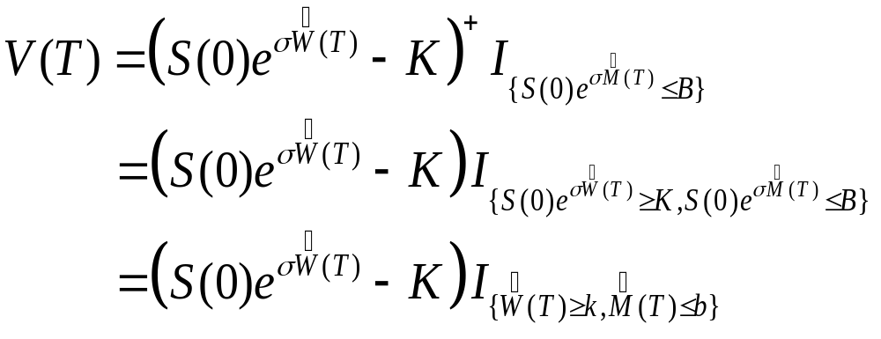
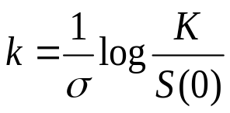
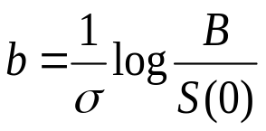
The option knocks out if and only if ; if , the option pays off
In other words, the payoff of the option is
(7.3.2)
where ,

Slide 6
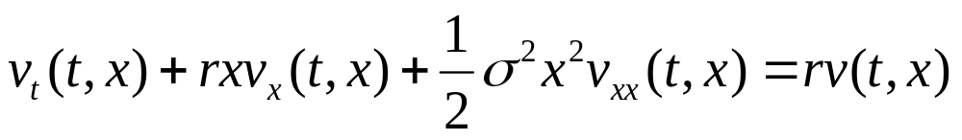

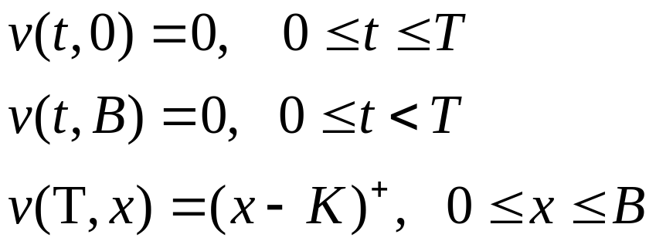
7.3.2 Black-Scholes-Merton Equation
Theorem 7.3.1
Let v( t, x) denote the price at time t of the up-and-out call has not knocked out prior to time t and S(t)= x. then v(t, x) satisfies the Black-Scholes-Merton partial differential equation
(7.3.4)
in the rectangle and satisfies the boundary conditions
(7.3.5)
(7.3.6)
(7.3.7)

Slide 7
(Theorem 7.3.1)
In particular, the function v( t, x) is not continuous at the corner of its domain where t=T and x=B. it is continuous everywhere else in the rectangle
Exercise 7.8 outlines the steps to verify the Black-Scholes-Merton equation direct computation..
Derive the PDE (7.3.4)
1. find the martingale
2. take the differential
3. set the dt term equal to zero

Slide 8

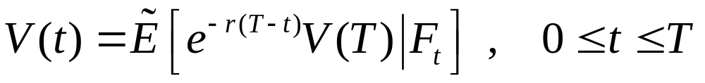
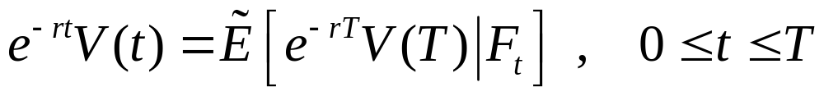
(Theorem 7.3.1)
Let an initial asset price S(0) (0,B) the option payoff V(T) by (7.3.2), and
(7.3.8)
The usual iterated conditioning argument shows that
(7.3.9)
is a martingale. We would like to use the Markov property as V(t)=v( t, S(t)), where the function in Theorem 7.3.1. However, this equation does not hold for all value of t along all path. Recall that v(t,S(t)) is the value of the option under the assumption that it has not Knock-out prior to t, whereas V(t) is the value if the option without any assumption.

Slide 9
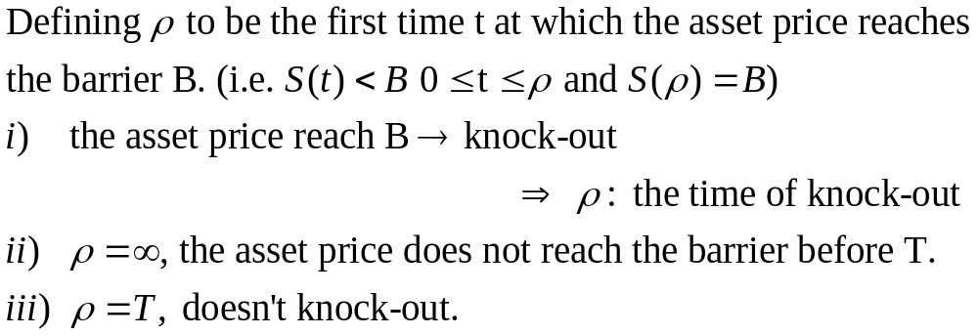
V(t) | v( t, S(t))
If the underlying asset price rises above the barrier B and then returns below the barrier by time t , then V(t)=0 | v( t, S(t))is strictly positive for all value of 0≦t≦T and 0<x<B
Path-dependent and remember that option has knock-out | Not path-dependence, when S(t)<B give the price under the assumption that it has not knock-out.

Slide 10
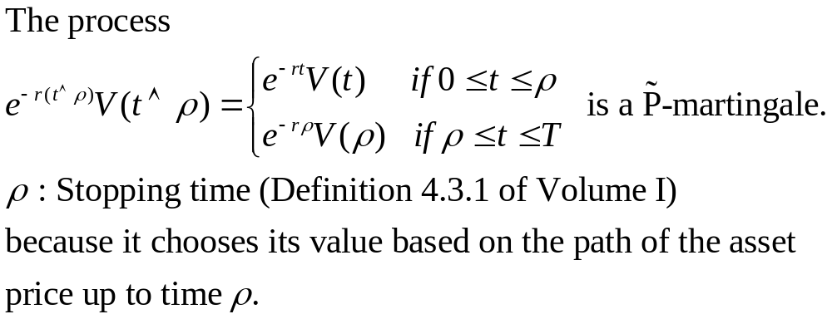
Theorem 4.3.2 of Volume I
A martingale stopped at a stopping time is still a martingale.

Slide 11


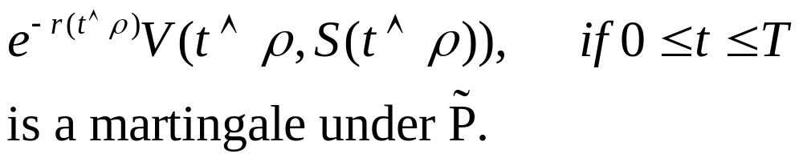
Lemma 7.3.2
We have
(7.3.11)
In particular, up to time ρ, or, put another way, the stopped process
(7.3.12)

Slide 12

SKETCH OF PROOF:
Because v( t, S(t)) is the value of the up-and-out call under the assumption that it has not knocked out before time t, and for this assumption is correct, we have (7.3.11) for
. From (7.3.11), we conclude that the process in (7.3.12) is the P-martingale (7.3.10).

Slide 13
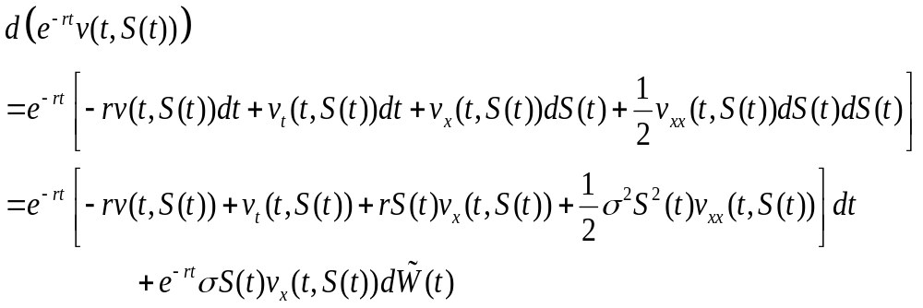



PROOF OF THEOREM 7.3.1:
We compute the differential (7.3.13)
The dt term must be zero for . But since ( t, S(t)) can reach any point in before the option knocks out, the equation (7.3.4) must hole for every and .

Slide 14
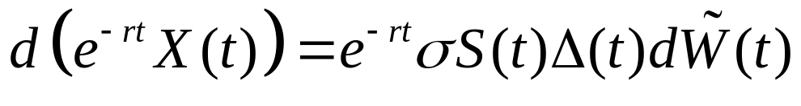
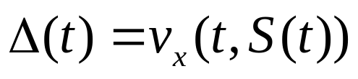
Remark 7.3.3
From Theorem 7.3.1 and its proof, we see how to construct a hedge, at least theoretically. Setting the dt term in (7.3.13) equal to zero, we obtain
Compare with the discounted value of a portfolio (5.2.27)
to get the delta-hedging:

Slide 15
Delta Hedging
Theoretically, if an agent begins with a short position in the up-and-out call and with initial capital X(0)=v( 0,S(0)), then the usual delta-hedging will cause her portfolio value X(t) to track the option value v( t, S(t)) up to the time ρ of knock-out or up to expiration T, whichever come first.
In practice, the delta hedge is impossible to implement if the option has not knocked out and the underlying asset price approaches the barrier near expiration of the option.

Slide 16
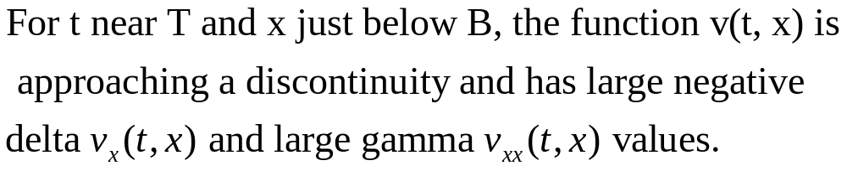
Problem:
∵ v(T, x) is discontinuous at x=B ( from B-K to 0 )
The Black-Scholes-Merton model assumes the bid-ask spread is zero, and here that assumption is a poor model of reality.

Slide 17
Solution:
The common industry practice is to price and hedge the up-and-out call as if the barrier were at a level slightly higher than B.
In this way, the large delta and gamma values of the option occur in the region above the contractual barrier B, and the hedging position will be closed out upon knock-out at the contractual barrier before the asset price reaches this region.

Slide 18
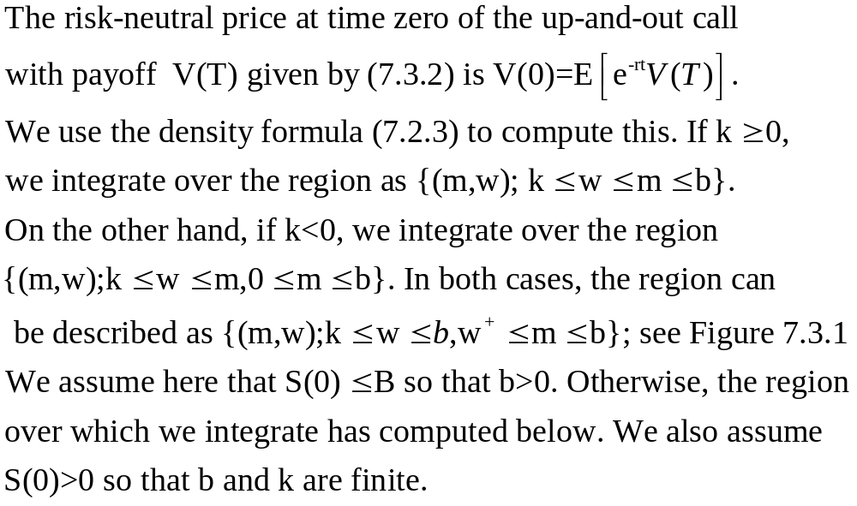
7.3.3 Computation of the price of the Up-and-Out Call

Slide 19
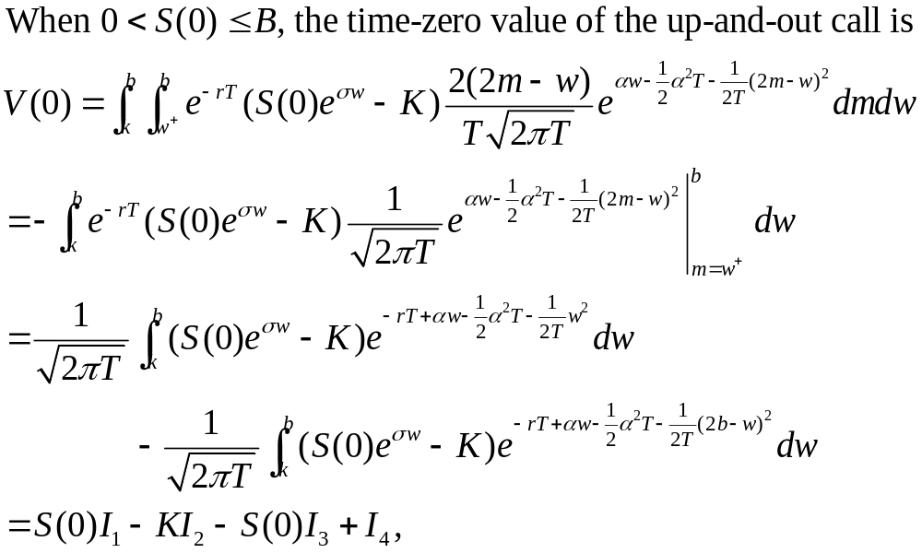

Slide 20
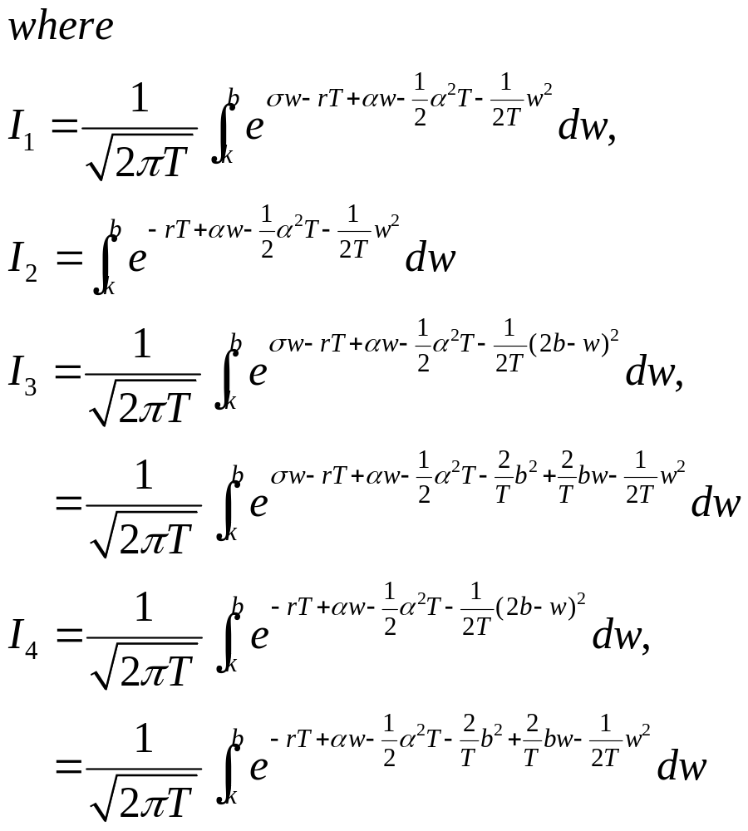

Slide 21
Fig. 7.3.1 Regions of integration for k≧0 and k<0
w
w
w=m
w=m
k
m
b
m
b
k

Slide 22
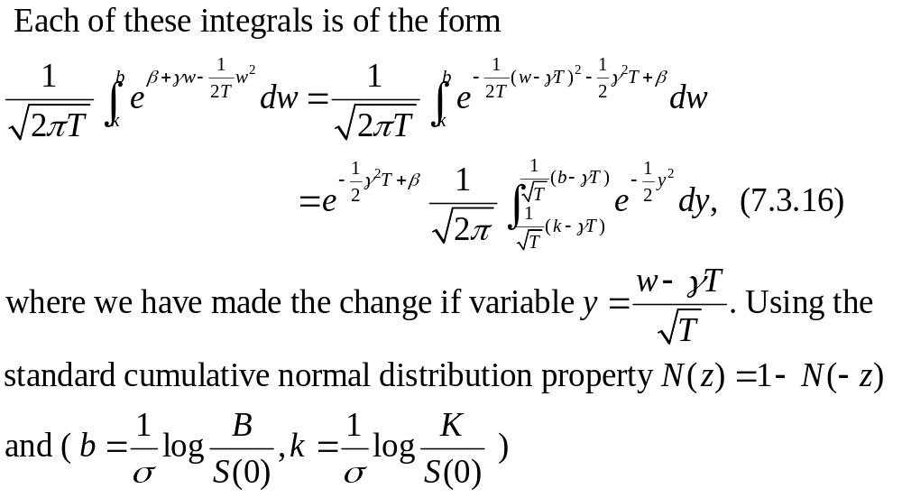

Slide 23
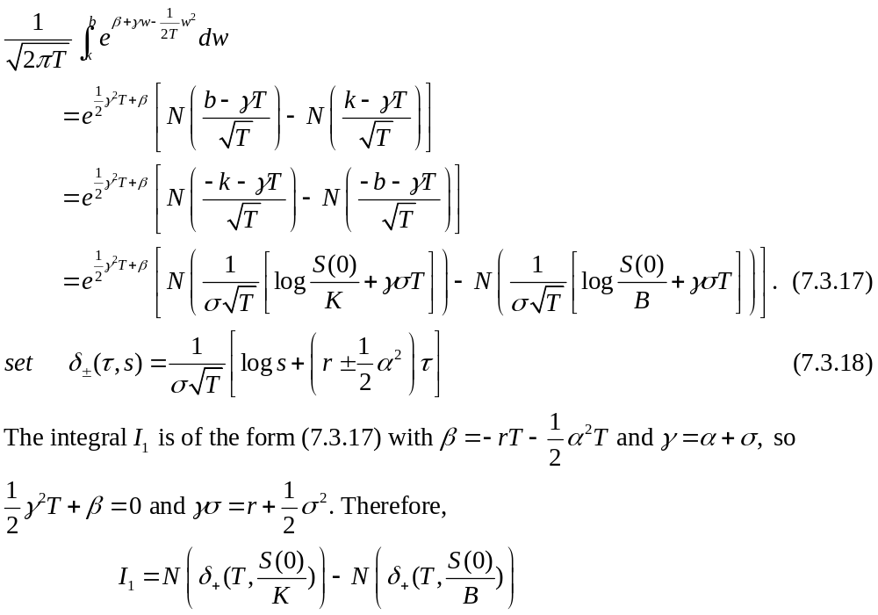

Slide 24
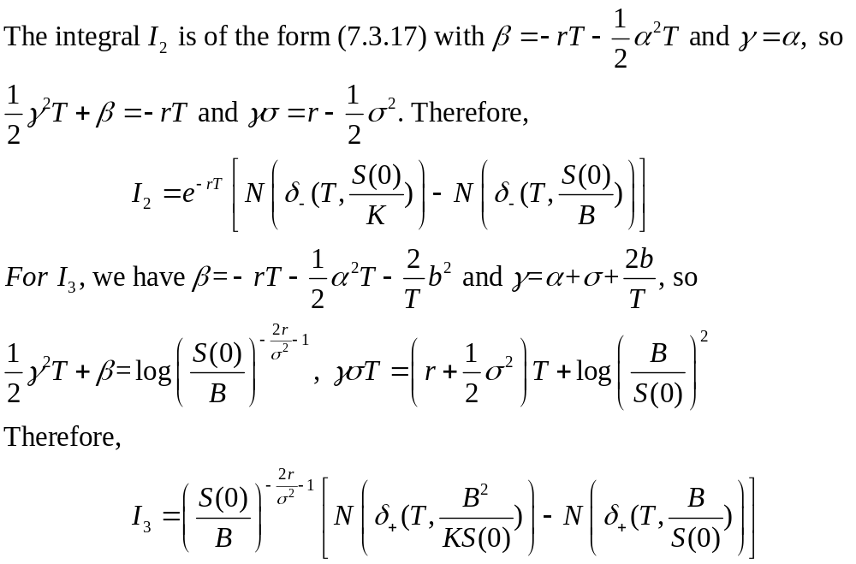

Slide 25
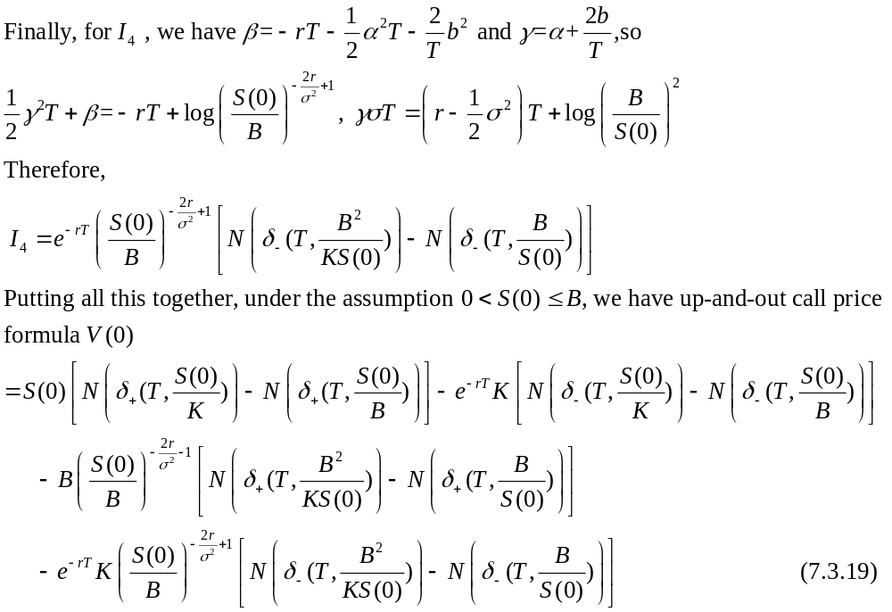

Slide 26
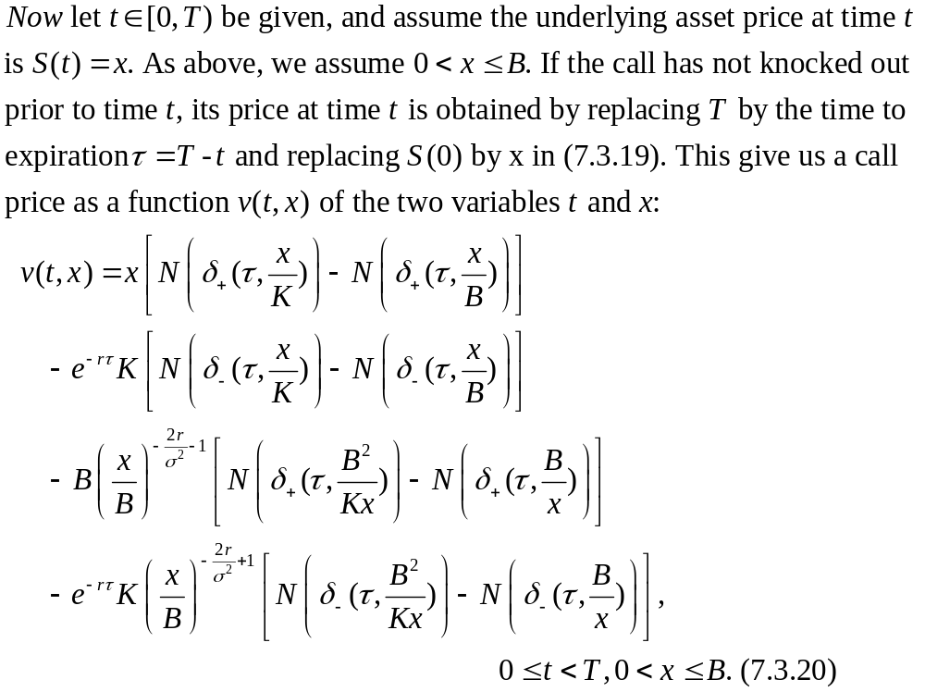

Slide 27
